Slide 1

Retail Sales Forecasting using Deep Learning
By
Vishnu varakala

Slide 2

Agenda
1.
overview
Problem Statement and Project Scope
2.
Data, Tools and technologies
Data Description, Data Profile Summary and Development Tool & Tech.
3.
Solution Approach
Development Approach, Model Selection and Evaluation Plan
4.
Exploratory Data Analysis
Key Insights Driving Model and Business Outcomes
5.
Results
Final Results – Summary & Comparison
6.
Conclusion
Model Discussion, Conclusion and Next Steps

Slide 3
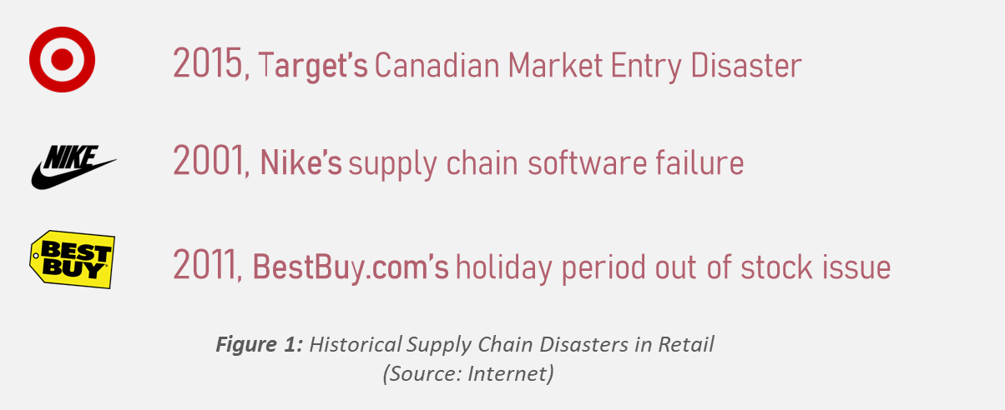
1. Overview
overview
Motivation
Supply chain and Inventory management is very vital any large or small scale business. For any business to grow and sustain long run in a market maintaining balanced flow is not an option but a must. Having an intuition on upcoming increase or decrease in demand helps businesses in making better strategic decisions related to inventory, which in turn not only improves cashflow and customer experiences (product availability) but also reduces retail shrinkage (due to wastage).
Be it 2001, Nike’s supply chain failure or 2011, BestBuy.com holiday period out of stock issue the importance of Demanding forecasting is time tested
Project Scope
“Complex problems needs innovative solutions”. Due to frequent changing & complex consumer purchase patterns traditional approaches like Moving Average, ARIMA and ARIMAX etc., might not provide expected demand forecast accuracy levels. With appropriate data treatment advanced Deep Learning techniques like MLP, LSTMs etc., can provided satisfactory results. The current project scope is to predict future retail store sales using MLP, CNN and LSTM deep learning techniques.
Each technique is evaluated on test and train datasets and final model is selected post comparative study.

Slide 4
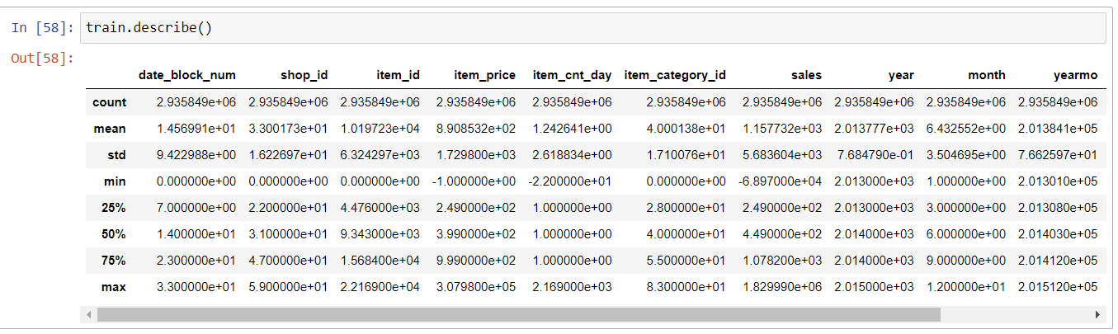



2. Data & Tools
Data, Tools and technologies
Description: Data used for the project consists of daily sales data at transaction level (Store – Item). Originally data belongs to on the Russia’s largest software firm – 1C Company. Which then was made available in Kaggle. Overall, 4 different tables pertaining to daily sales, product info, product category info and store info are available as part of data procured. Final master dataset (flat table format) is created by appropriately joining individual data sources.
Source: https://www.kaggle.com/
Summary: (Final master data create post joining individual sources): Data sourced has a good mix of categorical and continuous
Data Highlights
Data dictionary with quick analysis comments:
High level Data Summary
Key Data summary stats:
Tools and Technology
Programming Languages:
Python: For programming entire modeling pipeline
Key Libraries/Frameworks:
Tensorflow/Keras Frameworks: For utilizing DL Libraries

Slide 5



3. Solution
Solution approach
Architecture:
Train Dataset
(Jan’13 to May’15)
Data Rollup
(To Store-Month Granularity)
MLP Model (Keras)
Test-Train Split
CNN Model (Keras)
Model Validation on Test Dataset
Final model selection and comparative analysis
Store Sales Data
(Jan’13-Dec’15)
Outlier Treatment
(Excluding data post Sep’15)
Test Dataset
(Jun’15 to Aug’15)
LSTM Model (Keras)
Business Understanding
Data Gathering
Exploratory Data Analysis
Data Wrangling
Model Development
Model Validation & Deployment
Model performance on hold out data (test data) will be used for final model selection
Each model will be saved as pickle file for future referral
Model development and evaluation at store-month level data
MAPE and MAE are used as the primary metric for model validation and selection

Slide 6

3. Solution
Solution approach. Continued…..
Model Selection Intuition:
MLP
CNN
LSTM
Multilayer Perceptron
Convolutional Neural Networks
Long Short-Term Memory
Model Description (What?):
Multilayer perceptron models are one of the simplest form of neural networks. As the name suggests MLP model consists of multiple layers of stacked perceptions units (simple neural network units).
Due to the basic nature of MLP, they don’t have any concept of attention/memory which is essential for prediction tasks like forecasting were outcome from previous period plays a key role for predicting future.
Selection Intuition (Why?):
MLP approach has been selected as baseline model for current prediction task. Though MLP models doesn’t have the concept of looking back in time from algorithmic perspective, it can perform well if we induce it manually by creating engineering features based on time lag.
Model Description (What?):
Convolutional Neural Networks or CNN are special form of neural network originally developed for computer vision related task. CNNs are designed to extract useful patterns/features from a given dataset using key concepts of convolutions & filters.
Though CNNs are majorly used for computer vision related tasks, recently there has been increase in application of CNNs to time series data.
Selection Intuition (Why?):
CNNs in computer vision achieves prediction tasks through key feature/pattern extraction by individual filters. Time series forecasting can be viewed similar to that of computer vision where key patterns in peaks/valleys can be identified by filters. Due this reason CNN is selected experimentation.
Model Description (What?):
Long Short-Term Memory or LSTM models are advanced form of neural networks (especially RNN) designed to over come the problem of vanishing gradient and achieving long term memory dependencies. LSTM are majorly applied in NLP field as they are capable of generating predictions using data sequencies.
Selection Intuition (Why?):
Like the problem of predicting next word based on previous words in context, in NLP area, forecasting involves predicting future values based on past trends. Due to the capability of LSTMs to model the trend behaviour using memory, they can be applied to current forecasting problem with minimum data preparation.

Slide 7
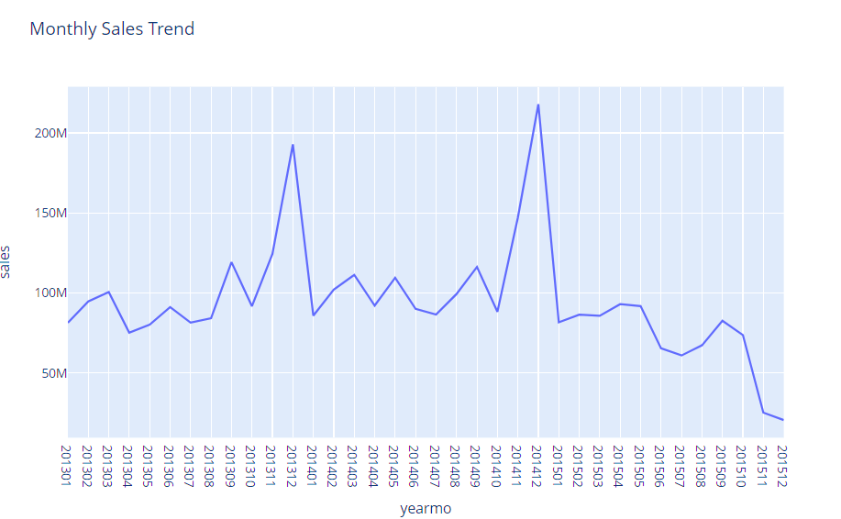

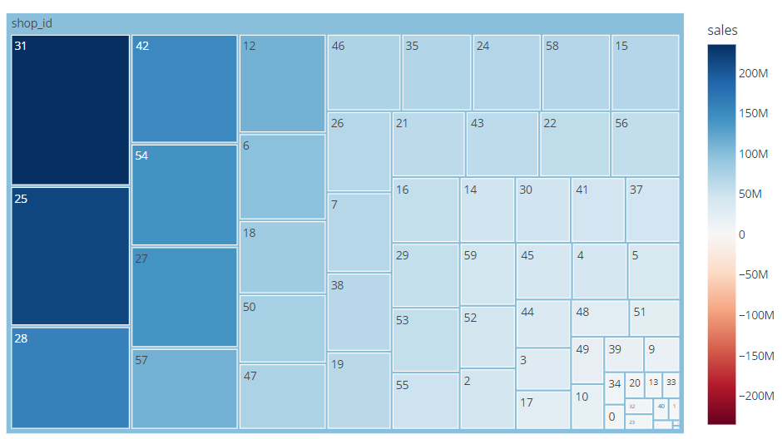
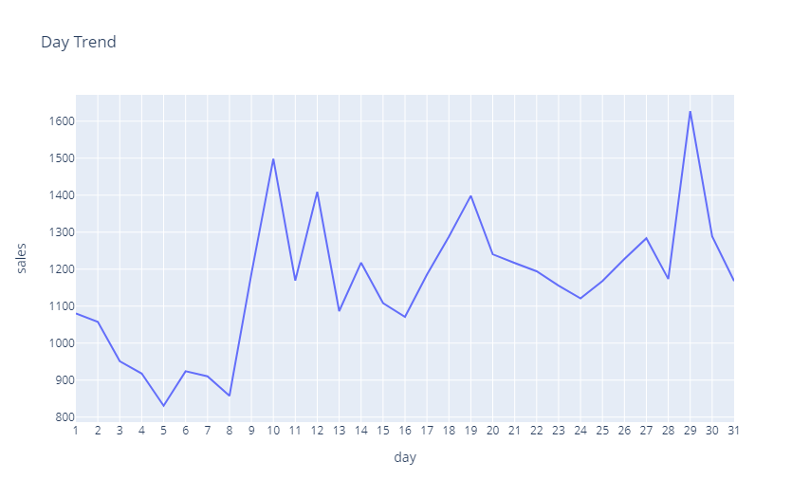
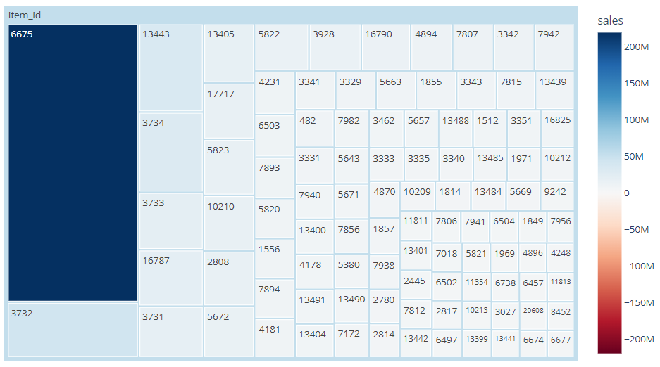
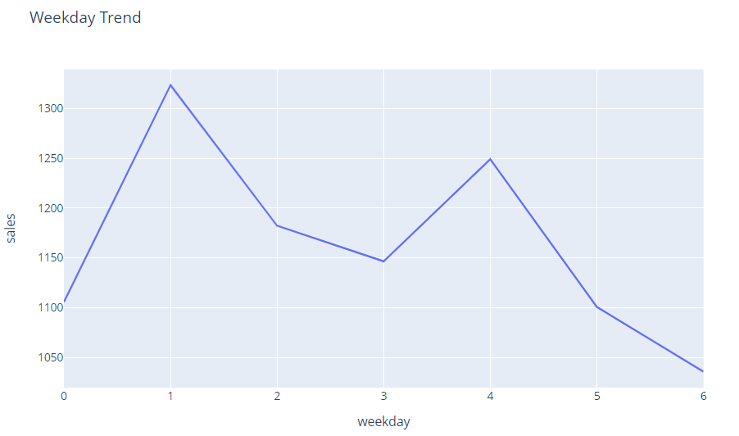
4. EDA
Exploratory data analysis
3
1
Dip in December month sales
1
30/64 (~50%) of the store are contributing to 80% of the sales. Nailing forecast for these 50% of the stores will generate quantifiable impact
From the Items which are sold during model period, only 8% of items contributed 80% sales
We have noticed a spike every December this might be due to festive period. But 2015 observed a decline which is counter intuitive, showing a possibility of data capture issue
Low sales at the beginning of every month and spike in the mid of month
Low sales captured in weekends
4
Low sales in month beginning
2
2
3
5
4
Low sales in month end
5

Slide 8

5. Results
Experiment results - MLP
MLP Model Best Iteration Results (Model stats reported at Store-Month level):
Train
Validation
Test
Best Test MAPE: 45%
MAPE:
29%
MAPE:
47%
MAPE:
45%
MSE:
426K
MSE:
75K
MSE:
328K
Multiple experimentation/iterations performed on MLP models; Best model exhibited 45% test MAPE on dataset with 29% train MAPE
Iterations with high train error exhibited high test error
MLP model showed consistent performance on both Test and Validation dataset suggesting consistency of model prediction
Model Iteration Results Snapshot
Test Period

Slide 9
5. Results
Experiment results - CNN
MLP Model Best Iteration Results (Model stats reported at Store-Month level):
Train
Validation
Test
Best Test MAPE: 52%
MAPE:
36%
MAPE:
67%
MAPE:
52%
MSE:
424K
MSE:
86K
MSE:
351K
Multiple experimentation/iterations performed on CNN models; Best model exhibited 52% test MAPE on dataset with 36% train MAPE
Iterations with high train error exhibited high test error
CNN model showed moderate performance variation from in Train, Test and Validation datasets
Model Iteration Results Snapshot
modelName | trainMAPE | trainMSE | testMAPE | testMSE | validMAPE | validMSE
cnnModel2022-11-25 13_42_33_572346 | 42% | 4,15,195 | 54% | 3,46,991 | 67% | 83,665
cnnModel2022-11-25 15_08_58_130654 | 66% | 6,92,733 | 73% | 4,02,233 | 89% | 1,06,204
cnnModel2022-11-25 15_15_28_236890 | 64% | 7,55,990 | 62% | 3,95,794 | 86% | 1,09,565
cnnModel2022-11-25 15_24_13_873554 | 59% | 6,20,929 | 74% | 4,19,152 | 85% | 1,02,650
cnnModel2022-11-25 15_37_27_628729 | 36% | 4,24,550 | 52% | 3,51,178 | 67% | 86,388
cnnModel2022-11-25 15_48_43_545865 | 30% | 3,80,023 | 50% | 3,50,350 | 64% | 83,848
cnnModel2022-11-25 16_20_23_117044 | 37% | 3,36,140 | 64% | 3,56,468 | 81% | 95,092
cnnModel2022-11-25 16_46_20_807323 | 39% | 3,75,052 | 54% | 3,54,781 | 71% | 83,234
Test Period
Test Period

Slide 10
5. Results
Experiment results - LSTM
MLP Model Best Iteration Results (Model stats reported at Store-Month level):
Train
Validation
Test
Best Test MAPE: 68%
MAPE:
70%
MAPE:
86%
MAPE:
68%
MSE:
795K
MSE:
111K
MSE:
620K
Multiple experimentation/iterations performed on LSTM models; Best model exhibited 68% test MAPE on dataset with 70% train MAPE
Iterations with high train error exhibited high test error
CNN model showed high variation on Train vs Validation dataset. This can be a sign of moderate overfitting
Model Iteration Results Snapshot
modelName | trainMAPE | trainMSE | testMAPE | testMSE | validMAPE | validMSE
lstmModel_2022-11-25 16_55_53_324926 | 66% | 8,63,664 | 86% | 4,44,669 | 85% | 1,16,532
lstmModel_2022-11-25 18_28_29_037051 | 68% | 8,56,714 | 78% | 4,31,523 | 89% | 1,15,730
lstmModel_2022-11-26 08_04_15_345606 | 70% | 8,68,453 | 74% | 6,15,724 | 89% | 1,16,945
lstmModel_2022-11-26 16_00_14_624793 | 70% | 7,95,221 | 68% | 6,20,039 | 86% | 1,11,336
lstmModel_2022-11-25 16_24_15_248476 | 71% | 8,86,312 | 88% | 4,57,277 | 92% | 1,19,576
lstmModel_2022-11-26 16_46_26_116117 | 72% | 7,92,023 | 72% | 6,36,024 | 90% | 1,10,751
lstmModel_2022-11-26 12_28_19_669260 | 73% | 8,02,793 | 75% | 6,36,585 | 92% | 1,13,814
lstmModel_2022-11-25 15_24_57_804397 | 76% | 8,84,260 | 88% | 4,52,108 | 96% | 1,20,060
lstmModel_2022-11-26 09_04_22_186614 | 79% | 9,09,531 | 82% | 6,30,926 | 99% | 1,21,989
lstmModel_2022-11-26 08_40_05_279868 | 81% | 9,11,266 | 85% | 6,54,229 | 101% | 1,23,043
lstmModel_2022-11-26 09_28_29_108843 | 99% | 18,20,039 | 99% | ######## | 99% | 2,15,190
Test Period

Slide 11
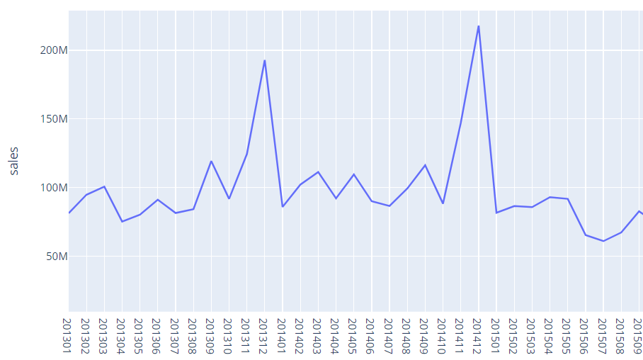
6. Conclusion
Conclusion and discussion
Of the three model architectures explored in current work Multilayer Perceptron model exhibited best test error (MAPE) in comparison with Convolutional Neural Networks and Long-Short-Term-Memory models. Best experiment/iteration of MLP model produced 45% Test MAPE with is ~7% more than the best experiment of CNN and 23% more than the LSTM’s best experiment.
Model performance on train and validation datasets is relatively very consistent in MLP experiments than that of CNN and LSTM. Though Convolutional showed good train MAPE of 36% but failed to perform on test dataset, while LSTM models failed to perform during both training and testing. One of the major reasons for all model exhibiting high test error is due to abnormal sales dip during the test period which was never observed in the past. Refer to the chart below on the dip observed. Exploring the reason for abnormal dip can help in treating the data for improved model performance and validation.
Drop in Test Period
Month
Figure: Monthly sales trend with abnormal drop in the during test period

Slide 12
Thank You

